Slide 1
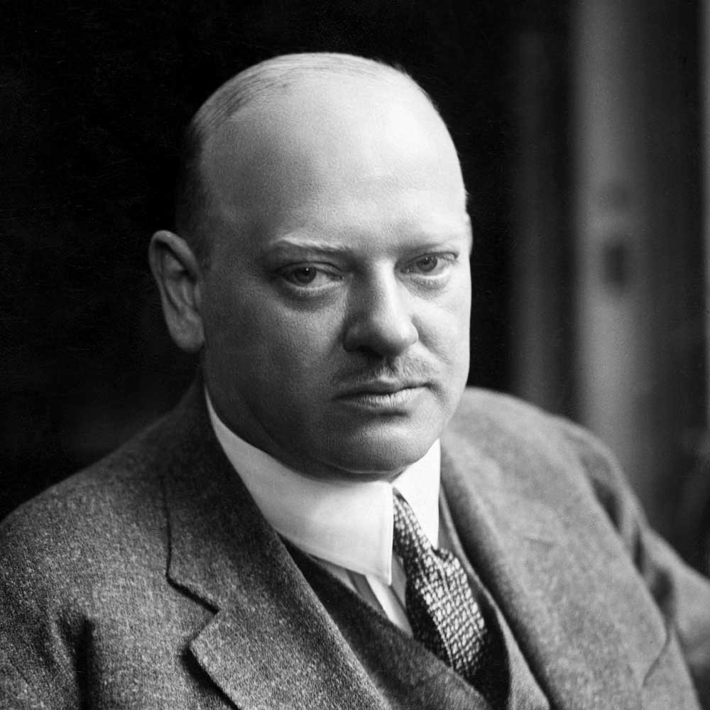
The Stresemann Era
Gustav Stresemann
The Voice of Moderation.
Gustav Stresemann became Chancellor and Foreign Minister in August 1923.
His new government was a coalition between his German People’s Party (DVP) and the Social Democrats.
WW1 General Paul von Hindenburg won the election for President by a large margin to replace Ebert, who had died of a burst appendix.

Slide 2
Stresemann’s Five Steps
Stresemann’s government was elected into the leadership of a society facing seemingly insurmountable problems. Political, social and economic issues were facing them at every turn.
Opposition to the government in general was rife within the community and social cohesiveness was at breaking point.
Stresemann’s government managed to stabilise German society to a large extent by achieving five key things: - Stabilizing the currency - Adopting the Dawes Plan in August, 1924 - Signing the Locarno Treaty in October, 1925 - Achieving admission into the League of Nations in September 1926 - The Young Plan of 1929.

Slide 3
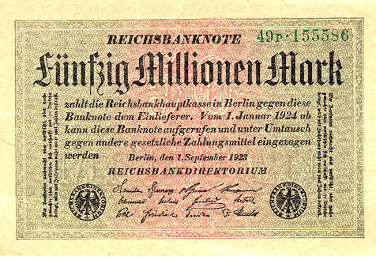
Stabilizing the currency.
On 13 November 1923, Hjalmar Schacht became Germany’s currency commissioner and introduced the Rentenmark as a temporary unit of currency.
The Rentenmark’s value was fixed at 4.2 trillion to the US Dollar which in turn stabilized the new Mark at 4.2 gold marks to the US Dollar.
The German mark was now fixed at a stable value, and as a consequence the hyperinflation was brought to a halt.
The printing and distribution of this new currency was strictly controlled by Schacht to ensure it was hold its worth.
This restored faith in the new currency and ended speculation about inflation returning to ruin the economy.
In August 1924, a new Reichsmark replaced the Rentenmark and Schacht was appointed president of the Reichsbank.

Slide 4
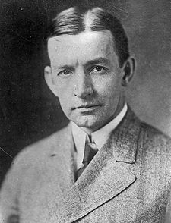
The Dawes Plan 1924
General Charles Dawes was the US representative on the Reparations Commission and put in charge of a 10 man committee to address whether the current reparations were viable for Germany to pay.
His report published in April 1924 recommended that: i. The Ruhr be evacuated by Allied occupation troops ii. Reparation payments were to be set at 1 billion marks for the first year and then increase to 2.5 billion each year over the next four. iii. The Reichsbank was to be reorganized, under Allied supervision. iv. Increased foreign loans would be made available to Germany, mainly from American banks. v. The money for reparation should include transport, exise, and customs taxes.

Slide 5
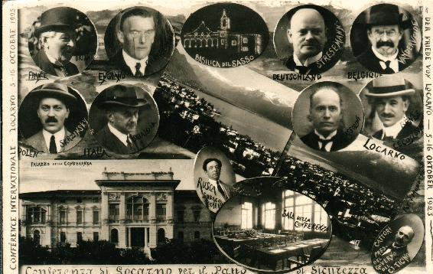
The Treaty of Locarno
Stresemann was keen to establish more harmonious relations with Germany’s former enemies. He met with representatives from France, Britain, Belgium, Italy, Czechoslovakia and Poland at Locarno in Switzerland from 5-16 October 1925.
An agreement was struck that Belgium, France and Germany would not attack each other and Britain and Italy were to act as guarantors.
The key principle was the understanding that any disputes would be settles with arbitration rather than military action.
The Treaty became an important feature of relations in Western Europe of the next few years.
Stresemann also signed the Treaty of Berlin with the Soviet Union in 1926 which quietened tensions on Germany’s eastern borders.
Germany was accepted into the League of Nations as a direct consequence of these Treaties.
Stresemann, Briand (French Prime Minister) and Chamberlain (British Prime Minister) were jointly awarded the Nobel Peace Prize in 1926.

Slide 6
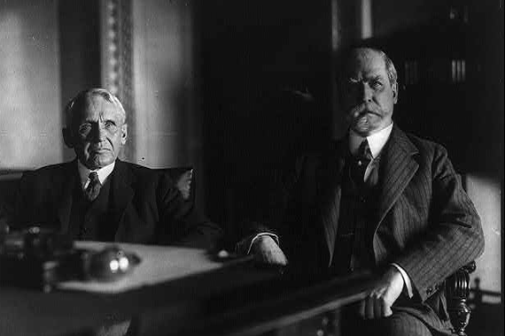
Kellogg-Briand Pact
Germany supported the Kellogg – Briand Pact of August 1928 between France and the United States.
It was designed to be an international treaty “providing for the renunciation of war as an instrument of national policy”.
It was signed by 15 countries including the US, Australia, Germany, Great Britain, Italy, Belgium, France and Japan.
A further 40 countries signed as “instruments of adherence”.
It failed in the long term as dramatic social, economic and political events dominated the 1930’s.

Slide 7
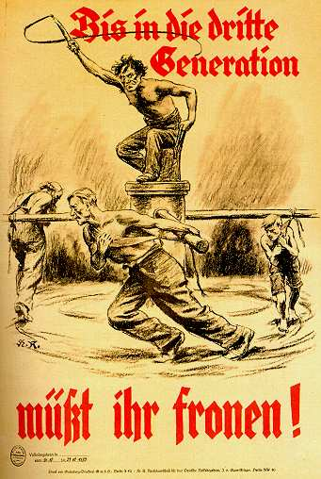
The Young Plan 1929
The Allied Reparations Committee appointed the American Owen D. Young to head a investigation into the reparations problem.
They recommended that Germany pay a sum of 40 billion Reichsmarks over 59 years, amounting to about 50% of Germany’s national income.
This was in addition to the external debt that Germany had already accumulated to the sum of 30 billion Reichsmarks.
Gustav Stresemann died on 3 October.
He had been a moderating influence on the political scene in Germany and wider Europe.
Wall Street crashes on 24 October, the economic shockwaves are felt globally.
Foreign lending to Germany came to a sudden halt and in light of this, the German governments decision to accept or reject the Young Plan became ever more difficult and contentious.

Slide 8
Opposition to the Young Plan
A ferocious campaign against the Young Plan was launched by members of the Right.
A selection of nationalist politicians formed the Reich Committee for a German Referendum, demanding that the decision on the Young Plan be put to the people.
This group was dominated by the Right’s new rising star, Adolf Hitler.
Hitler believed that the Young Plan was tacit acceptance of “war guilt” and anyone who agreed to it was guilty of treason.
The Referendum was held on 22 December 1929 but only received 5.8 million votes of the 22 million required for success.
The Reichstag accepted the Young Plan the following March and Hindenburg signed it ‘with a heavy heart”.

Slide 9
https://www.youtube.com/watch?v=26EB3F7CgbE

